Slide 1
Web App Migration Assessment
Rogba Adeyemi
April 7, 2022

Slide 2
Innovate with Azure
Problem Statement
Existing Infrastructure
Proposed Solution
Requirements mapping
Solution Architecture
Workflow
Considerations & Recommendation
Next Steps
Agenda

Slide 3

Infrastructure to match your business ambition
Innovate with Azure Cloud
Free up resources and refocus employees to generate business value from driving forward innovation. On-site data centers require a lot of hardware setup, software patching, and other time-consuming IT management chores. With Azure, you can eliminate the burden of maintenance, so IT teams can spend time on achieving more important business goals.

Slide 4
Problem Statement
The customer is interested in leveraging the maximum potential availability within Azure to migrate her existing web application infrastructure to the Public Cloud.
The solution needs to be:
•highly available, scalable, and flexible
•utilize only native Azure Services and Products.
•deployable completely using Infrastructure as Code (IaC) from a single codebase

Slide 5
Existing Infrastructure
The solution will assess the client strategy to migrate on-premises NodeJS customer facing web application behind a NGINX reverse proxy to the public cloud by addressing the following challenges.
Consider OS level access in the developed solution
MongoDB is to be retained as the database technology
Processes generating PDF files which are stored locally.
The finance team needs to have access to these files via FTP.
All services are hosted on several virtual machines.
The 3 environments, namely Test, Acceptance and Production are to be kept in Azure, while following best practices in terms of workload isolation.
The region of choice is West Europe.
They want to go live in Azure within 9 months.

Slide 6
Proposed Solution
The NodeJS application will be hosted in Azure App Service, which supports hosting Node.js apps in both Linux (Node versions 12, 14, and 16) and Windows (versions 12 and 14) server environments. The MongoDB database will be hosted in Azure Cosmos DB, a cloud native database offering a 100% MongoDB compatible API.

Slide 7
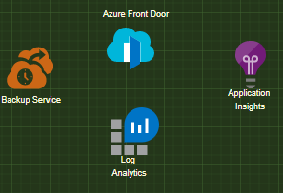

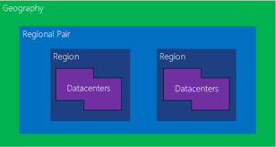
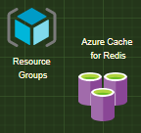
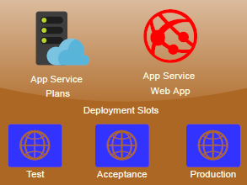
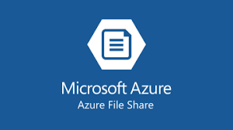
Requirements Mapping

Slide 8
Considerations & Recommendation
High Availability – across regions
Azure Front Door automatically fails over if the primary region becomes unavailable.
Cosmos DB RPO and recovery time objective (RTO) for Cosmos DB provide trade-offs between availability, data durability, and throughput.
Storage. RA-GRS storage provides durable storage.
Manageability. If the primary database fails, perform a manual failover to the secondary database.
DevOps. Azure Monitor provides analytics to monitor on-premise and cloud environments.
Security. Consider using Microsoft Defender for Cloud to monitor potential security issues
Pricing. Use the pricing calculator to estimate costs.

Slide 9
Next Steps
Azure Migrate for all your needs
The App Service migration assistant—a fast, free, and automated way to migrate web apps with minimal or no code changes. Run readiness checks and get potential remediation steps for common issues. Receive step-by-step guidance for moving your web app to App Service.

